Slide 1
Strategies for Early Awareness of College Opportunities
I KNOW I CAN
Youth Leadership Academy
National College Access Network

Slide 2
Presenters Moderator
Dianha Ortega-Ehreth
Executive Director
Youth Leadership Academy
Elgin, IL
dortega-ehreth@elgin.edu
www.ylaecc.org
Blossom Barrett
Grants, Research, and Evaluation Manager.
I Know I Can
Columbus, OH
bbarrett@iknowican.org
http://iknowican.org
Carrie Warick
Director of Partnerships and Policy
National College Access Network
Washington, DC
warickc@collegeaccess.org
www.collegeaccess.org

Slide 3
Early Awareness Overview
Notes:
Ask group for their definition
Help students on the pathway
Talk about early awareness for financial aid, but needs to be broader too
Fed most important because available to all
Students need to know what’s locally available and state aid too

Slide 4
Why is Early Awareness Important?
Expectation Setting
Financial Literacy
Making a Plan
Notes:
Great Schools survey found 92% of middle schools aspire to go to college, up from over 80% in an NASSP survey from 2007.
Actual college going numbers much lower – why are they opting out?
Not know steps to get there, receive no or negative messages about college going

Slide 5
NCAN Early Awareness Resources
Research Compendium:
www.collegeaccess.org/earlyawarenesspolicy
Program Profiles:
www.collegeaccess.org/blog (EA Filter)
Middle Grades Toolkit:
www.collegeaccess.org/EarlyAwarenessMiddle
Grades 9-10 Toolkit:
www.collegeaccess.org/Early_Awareness
Notes:
Compendium – Research and results on the types of EA programs
Information programs
Federal GEAR UP cohort model
College savings accounts
Scholarship programs
Also: More research needed in this area of college access
How many of you are involved in an EA program?
Survey on which type (promise part of scholarship)

Slide 6
I Know I Can
Founded in 1988
Columbus, Ohio
College access provider for Columbus City Schools
To inspire, enable and support
Columbus City Schools students in pursuing
and completing a college education
Notes:
8min overview

Slide 7
I Know I Can
Retention and Persistence Services
On-campus and distance advising for 17 Ohio postsecondary institutions
Specialized Pre-Enrollment Workshops
Chronus Mentor Platform
High School College Access Advising
A fulltime advisor in each CCS high schools
College application and entrance exam fee waivers
Naviance Succeed
Notes:
8min overview

Slide 8
I Know I Can
Financial Services
Save Smart, Individual Development Accounts
I Know I Can Grant $1,200
Founders’ Scholarship $10,000 (per year, 4 years)
FAFSA Workshops
Early Awareness Services
I Know I Can Book
Naviance Succeed (Advisor guided)
Blueprint:College
Notes:
8min overview

Slide 9
Youth Leadership Academy – Brief History
Started in 1996 as a program of Elgin Community College
2000 – became a 501c3
Unique approach in recruiting families who have students in 6th grade
Focus on 6 year commitment
2 Saturdays per month during the school year x 6 years = MINIMUM 360 hours of leadership training

Slide 10
Youth Leadership Academy – Brief History
Started in 1996 as a program of Elgin Community College
2000 – became a 501c3
Unique approach in recruiting families who have students in 6th grade
Focus on 6 year commitment
2 Saturdays per month during the school year x 6 years = MINIMUM 360 hours of leadership training

Slide 11
YLA is a vibrant community
Staff team of 20 trainers, mentors, coaches and volunteers
12-15 service learning projects as part of leadership development program – serving the community too!
Success Skills – extended time to help cadets with academic learning skills
Parent classes
Community volunteering

Slide 13
YLA highlights
YLA Cadet Retention Rate - 97.5%
100% parent meeting participation 2 years in a row
58 – Average number of parents who attend YLA parent meetings on any given YLA Saturday
100% of YLA Class of 2016 enrolled in a college!
9 are enrolled at ECC
6 are enrolled at other institutions including Michigan State University, University at Illinois Champaign/Urbana, UIC and Judson.

Slide 14
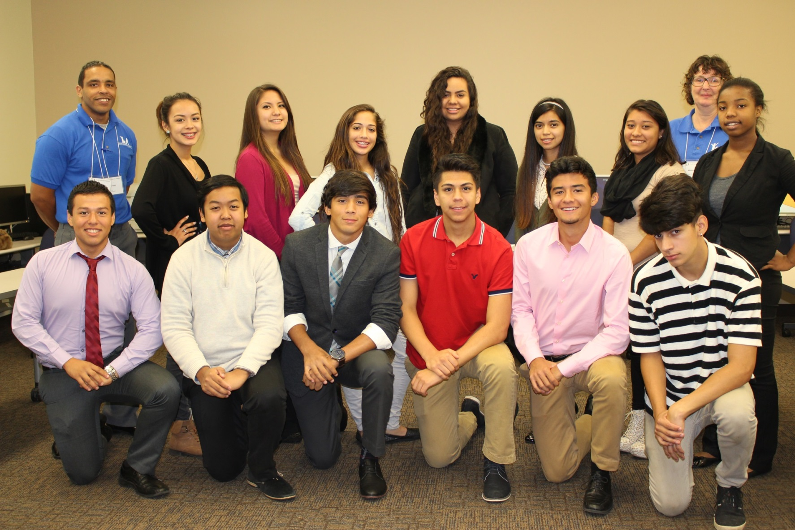
YLA Class of 2016

Slide 15
Discussion followed by Question and Answer
Dianha Ortega-Ehreth
Executive Director
Youth Leadership Academy
Elgin, IL
dortega-ehreth@elgin.edu
www.ylaecc.org
Blossom Barrett
Grants, Research, and Evaluation Manager.
I Know I Can
Columbus, OH
bbarrett@iknowican.org
http://iknowican.org
Carrie Warick
Director of Partnerships and Policy
National College Access Network
Washington, DC
warickc@collegeaccess.org
www.collegeaccess.org

